Slide 1
Chapter 4: Building Knowledge Base

Slide 2
Building knowledge base
How to represent and manipulate structured data.
Prolog as a natural database query language.
A database is represented in Prolog as a set of facts

Slide 3
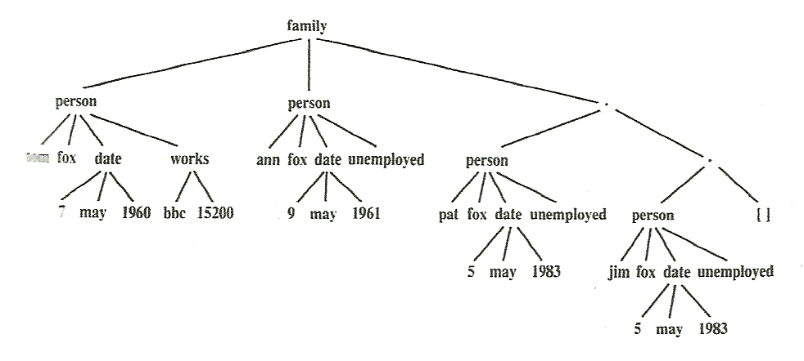
Building knowledge base
Each family has 3 components:
husband, wife, list of children.
Each person has 4 components:
name, surname, date of birth, job.
The job info is ‘unemployed’ or has 2 components:
organization, salary

Slide 4
Building knowledge base
family( person(tom,fox,date(7,may,1960),works(bbc,15200)),
person(ann,fox,date(9,may,1961),unemployed),
[ person(pat,fox,date(5,may,1983),unemployed),
person(jim,fox,date(5,may,1983),unemployed) ]).

Slide 5
Building knowledge base
family( person(tom,fox,date(7,may,1960),works(bbc,15200)),
person(ann,fox,date(9,may,1961),unemployed),
[ person(pat,fox,date(5,may,1983),unemployed),
person(jim,fox,date(5,may,1983),unemployed) ]).
How to retrieve desired information?

Slide 6
Building knowledge base
We can specify objects of interest not by their contents, but by their structure, leaving their arguments as unspecified slots.

Slide 7
Building knowledge base
We can provide procedures to make the interaction with the database easier.
Some useful utility procedures for our database are:
husband, wife, child, exist, date of birth, salary
husband(X):- family(X,_,_).
wife(X):- family(_,X,_).
child(X):- family(_,_,L), member(X,L).
exist(X):- husband(X); wife(X); child(X).
dateofbirth(person(X,Y,Date,_),Date).

Slide 8
Building knowledge base
Using the previous utilities:
Find the names of all people in the database?
?- exist(person(Name,Surename,_,_).
Find all children born in 2000?
?- child(X), dateofbirth(X, date(_,_,2000).
Find the names of families with at least three children?
?- family(person(_,Name,_,_),_,[_,_,_|_]).

